Slide 1
CMPE 255 Significant Paper Presentation
An Efficient CRM-Data Mining Framework for the Prediction of Customer Behaviour
Presented by:
Ryan Haoyuan Wang
Chao Pi
Xunan Dai

Slide 2
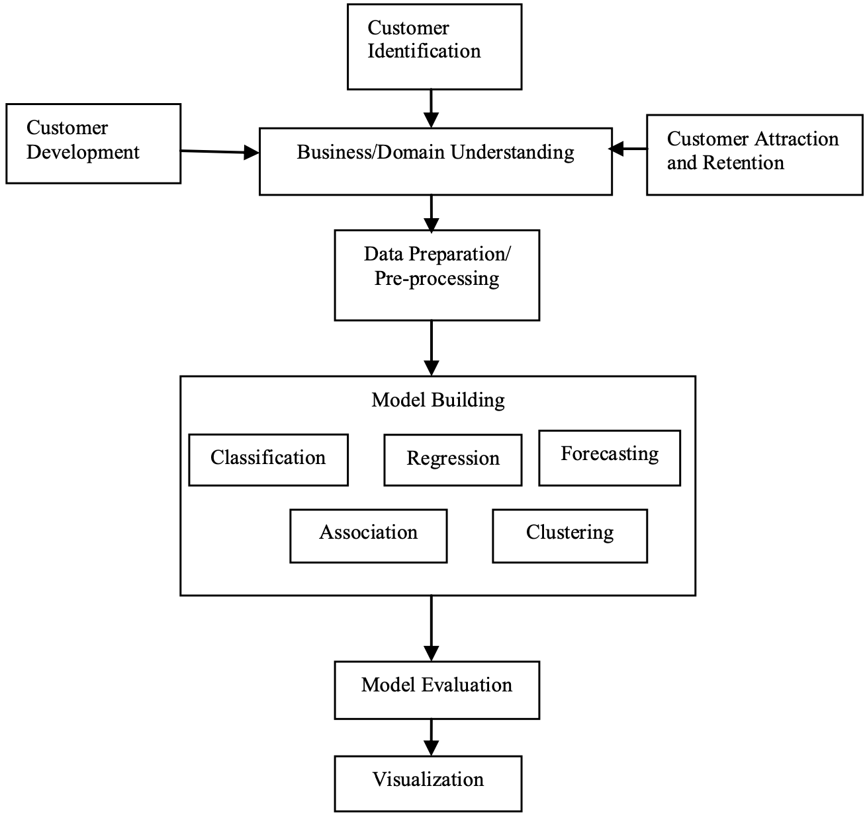
What the Article was About
Proposed a data mining framework for customer relationship management systems
Dataset is from a Portuguese bank for 17 campaigns offered customers with an long-term deposit application
Data preprocessed with Rattle analysis and CRISP-DM iterations
Classification with MLPNN and NB are implemented
Notes:
As you might know, customer relationship management system stores a huge amount of customer information that needs to be processed in order to retrieve important hidden information.
The significant paper proposed this framework on the right that can facilitate a such CRM system to extract information that a company might need.
It starts with customer identification and using business and financial understanding to select important features for later data preprocessing. The processed data then are fed into a model with various algorithm for model building. The model is then evaluated and visualized.

Slide 3
Different evaluation metrics are used
Sensitivity, Specificity, TPR, FPR and ROC areas
The main metric the paper used is accuracy rate
88.63% and 87.97% with MLPNN and NB, respectively
Paper concluded that the best model is MLPNN based on accuracy
What the Study Found

Slide 4
Opinion on the Study
Data preprocessing with simply dropping instances with missing values causes information loss
More classification models can be applied to have a further comprehensive investigation
The validation and evaluation used in the study is the most common methods which are good to present the performance of the models
A more throughout investigation

Slide 5
Key Learning
Basic structure of data mining framework for CRM analysis
Customer identification, business/domain understanding, data preparation, model building, model evaluation and visualization.
Data preprocess procedures on customer’s information
Attributes relevant to the business decision making using Rattle analysis and CRISP-DM iterations to reduce the features
Evaluation methods to compare the result
Confusion matrix, ROC areas and time to build models
Classification models selection
Suggested Neuro fuzzy classifiers and ensemble of classifiers

